Slide 1

Internship Completion Report. ~ 29th May,23 – 28th July,23
~ Rohan Sakkarwal
~ Ankit Kumar
~ Parvesh Kumar Sirmoria

Slide 2
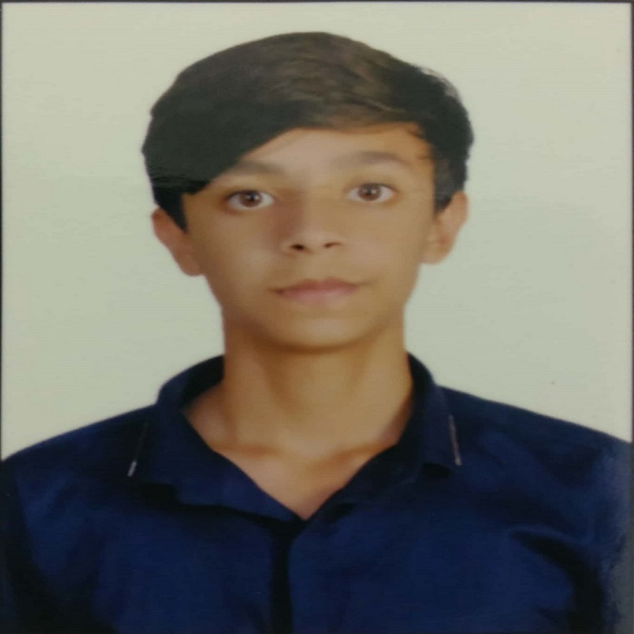
Introduction of Interns
Name: Rohan Sakkarwal Age: 20years
~ 4th year student pursuing Bachelor in Technology in
Computer Engineering from DTU.
~ Internship at Siemens (29th May,23 to 28th July)
~ Good hands in coding and have knowledge about
-> C++, JAVA
-> OOPS , DBMS
-> Web Development
~ Hobbies
-> Sports (National Level player in Basketball)
-> Dance (Won street battles)
-> Orange belt in Taekwondo

Slide 3
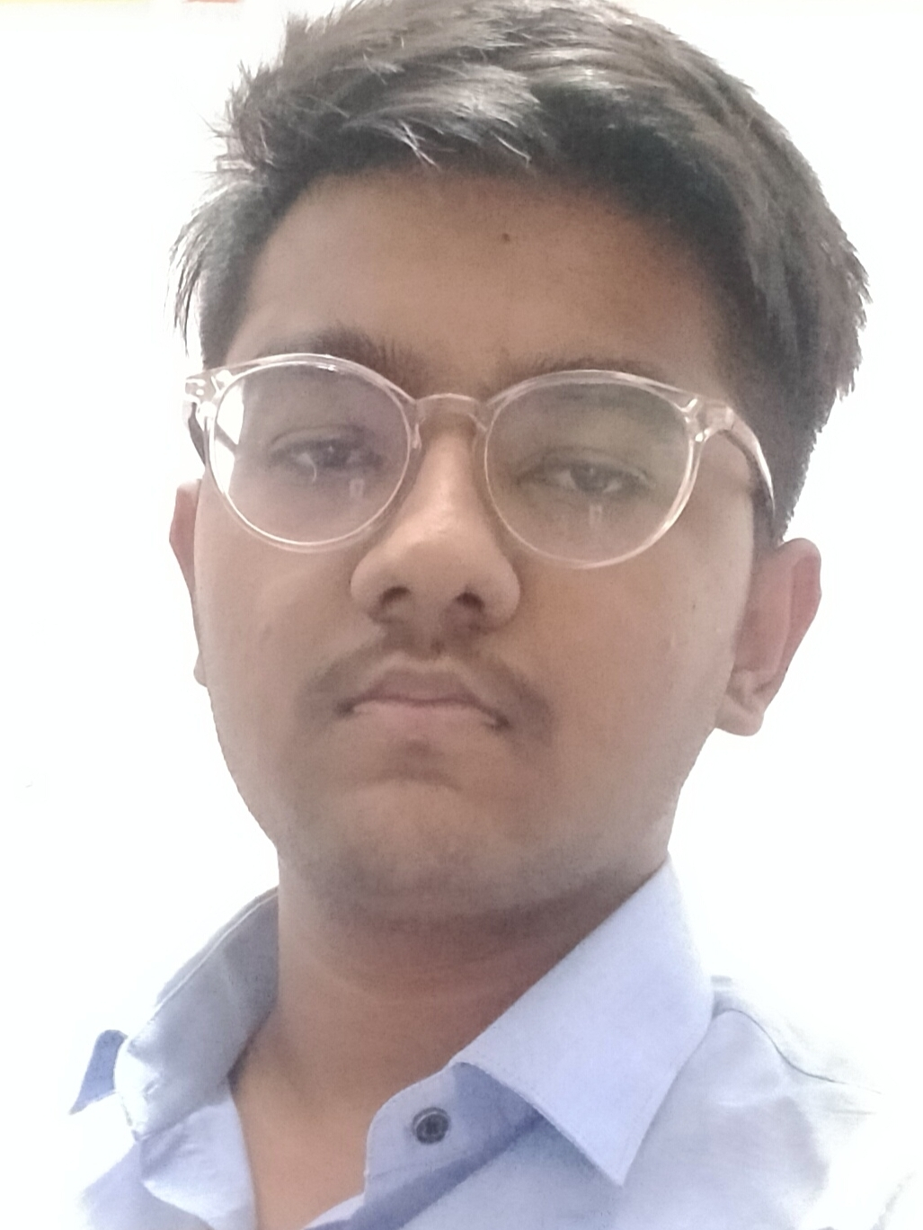
Introduction of Interns
Name: Ankit Kumar Age: 21years
~ 4th year student pursuing Bachelor in Technology in
Information Technology from DTU.
~ Internship at Siemens (29th May,23 to 28th July)
~ Good hands in coding and have knowledge about
-> C++
-> OOPS
-> Web Development
~ Hobbies
-> Reading books
-> Blogging

Slide 4
What have we done in these 2 months?
1st Month
-> Overview about Energy IP.
-> Strengthen our technical aspects like: -
JAVA
OOPS
Spring boot
Apache camel
2nd Month
Started working on the project

Slide 5

PROJECT INTRODUCTION
Project Name: Non-Technical Losses Analytics project
~ Aims to leverage
advanced data analytics,
machine learning techniques, and
statistical modeling
to analyze vast amounts of data collected from various sources.

Slide 6

PROJECT DESCRIPTION

Slide 7

CONTENTS
PROJECT
OVERVIEW
PROJECT
CONTENT
Challenges
Faced
01
02
03

Slide 8

PROJECT
OVERVIEW
01

Slide 9
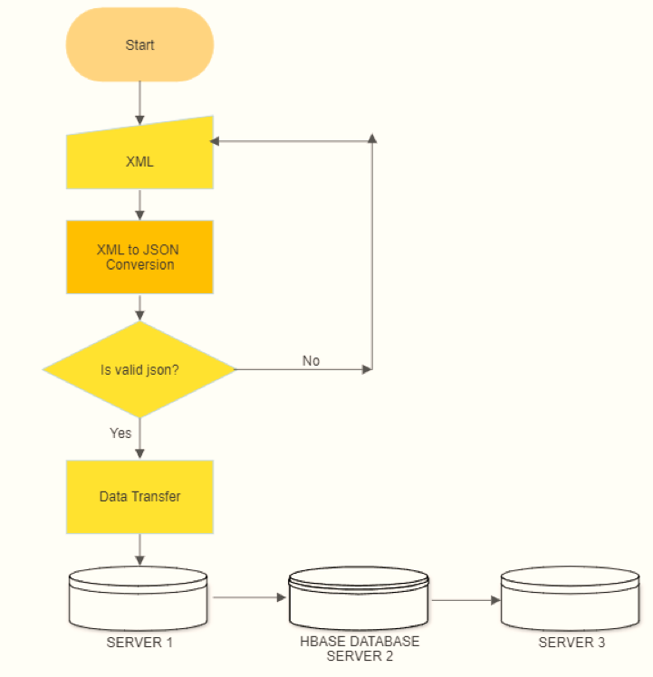
FLOW CHART

Slide 10

PROJECT
DEVELOPMENT REQUIREMENTS
JAVA
Primary language of the project.
Eclipse IDE
JAVA IDE required for developing java application.
Requirement
Maven Dependencies
Dynamic dependencies for proper export of project.
Apache Camel
Required for trasferring files via routes.
Git
For version control of the project.

Slide 11
PROJECT
DETAILED OVERVIEW
XML to JSON
Converting our sample input xml file to json
Validating JSON
Checking all the attributes of json is correct or not.
Data Transfer
Transferring files to servers via apache camel.

Slide 12
PROJECT
02
CONTENT

Slide 13
PROJECT
CONTENT
Validate.java
XMLmap.java
Checking if we are gettign all the attributes.
Java file to map our Xml file to json.
filetransferviacamel
Output buffer
Storing files to be sent in output folder.
Sending files through routes of Apache Camel.

Slide 14
PROJECT
CODE FLOW
Xml file
Xml Doc obj
XML String
JSON obj
File Sent
Apache Camel
Connecting to vpn
JSON File
Xml to json
Output file
Apache Camel

Slide 15
CHALLENGES
FACED
03

Slide 16


Strengths
Weaknesses
Opportunities
Treats
JAVA
Apache Camel
System Admin
Knowledge
IDE
Connecting to server
Git control
Linux
Wow
O
T
S
W

Slide 17



THANKS!

